Slide 1
--Question 1 - Players with high S.R who have faced at least 500 balls.
QUERY:-
select batsman,
sum(batsman_runs) as runs,
count(case when extras_type != 'wides' then ball end) as balls_faced,
round((sum(batsman_runs)*100.0/count(case when extras_type != 'wides' then ball end)),2) as strike_rate
from ipl_ball
group by batsman
having count(case when extras_type != 'wides' then ball end)>=500
order by strike_rate desc limit 10;

Slide 4
--Question 2 - Players with good Average who have played more than 2 ipl seasons.
QUERY:-
select a.player_of_match,
count(distinct extract('year' from a.date)) as season_played,
b.total_runs,
b.batsman_dismissed,
round(b.total_runs*1.0/nullif(b.batsman_dismissed,0),2) as average_strike_rate
from ipl_matches as a
join (select batsman,
sum(batsman_runs) as total_runs,
count(case when is_wicket != '0' then is_wicket end) as batsman_dismissed
from ipl_ball group by batsman)as b
on a.player_of_match=b.batsman
group by a.player_of_match,b.total_runs,b.batsman_dismissed
having count(distinct extract('year' from date))>2
order by average_strike_rate desc limit 10;

Slide 7
--Question 3 - Hard-hitting players who have scored most runs in boundaries and have played more then 2 ipl season.
QUERY:-
select a.player_of_match,
count(distinct extract('year' from date)) as season_played,
b.no_of_boundaries,
b.total_runs,
round(b.no_of_boundaries*100.0/nullif(b.total_runs,0),2)as boundary_percentage
from ipl_matches as a
join (select batsman,
count(case when batsman_runs='4' or batsman_runs='6' then batsman_runs end)as no_of_boundaries,
sum(batsman_runs) as total_runs
from ipl_ball group by batsman)as b
on a.player_of_match=b.batsman
group by a.player_of_match,b.no_of_boundaries,b.total_runs
having count(distinct extract('year' from date))>2
order by boundary_percentage desc limit 10;

Slide 10
--Question 4 - Bowlers with good economy who have bowled at least 500 balls in IPL so far.
QUERY:-
select bowler as bowler_name,
round(sum(total_runs)/(count(bowler)/6.0), 2) as economy
from ipl_ball
group by bowler
having count(bowler)>=500
order by economy desc limit 10;

Slide 13
--Question 5 - Bowlers with the best strike rate and who have bowled at least 500 balls in IPL so far. with good economy who have bowled at least 500 balls in IPL so far.
QUERY:-
select bowler as bowler_name,
count(bowler)as no_of_balls_bowled,
sum(case when is_wicket != '0' then is_wicket end) as total_wickets,
round(count(bowler)*1.0/sum(case when is_wicket != '0' then is_wicket end),2) as bowler_sr
from ipl_ball
group by bowler
having count(bowler)>=500
order by bowler_sr limit 10;

Slide 16
--Question 6 - All rounders who have faced at least 500 balls in IPL so far and have bowled minimum 300 balls.
QUERY:-
select batsman as all_rounder,
round((sum(batsman_runs)*100.0/count(case when extras_type != 'wides' then ball end)),2) as batsman_sr,
b.bowler_sr
from ipl_ball as a
inner join (select bowler,
round(count(bowler)*1.0/sum(case when is_wicket != '0' then is_wicket end),2) as bowler_sr
from ipl_ball
group by bowler
having count(bowler)>=300
order by bowler_sr asc) as b
on a.batsman=b.bowler
group by batsman,b.bowler_sr
having count(case when extras_type != 'wides' then ball end)>=500
order by batsman_sr desc,bowler_sr asc limit 10;

Slide 19
--Question 7 – Wicketkeeper criteria
To choose the two best wicketkeeper we need to consider a combination of batting, fielding, and overall impact of the player.
1.Aggressive batting
2.Good batting strike rate
3. Fielding
4. Boundaries hitter
5. Average bowling strike rate
Player with good strike rate, aggressive playstyle, fielding with dismissal kind as run out, caught are potential players for wicket keeping as they anchor the field at the strike end and have a complete visual of the ground, can place the players on the field in a way where the runs for opponent can be stopped.

Slide 20
--Additional Questions for Final Assessment
QUERY:-
create table deliveries as
(select * from ipl_ball)
create table matches as
(select * from ipl_matches)

Slide 21
1. Get the count of cities that have hosted an IPL match
QUERY:-
select city,
count(case when city != 'NA' then city end) as host_city
from matches
group by city
order by city;

Slide 23
2. Create table deliveries_v02 with all the columns of the table ‘deliveries’ and an additional column ball_result containing values boundary, dot or other depending on the total_run.
QUERY:-
create table deliveries_v02 as
(
select *,
(case when total_runs>='4' then total_runs else '0' end) as boundaries,
(case when total_runs='0' then 'dot' else '0' end) as dot,
(case when total_runs<'4' then total_runs else '0' end) as total_run
from deliveries
)
select * from deliveries_v02;

Slide 24
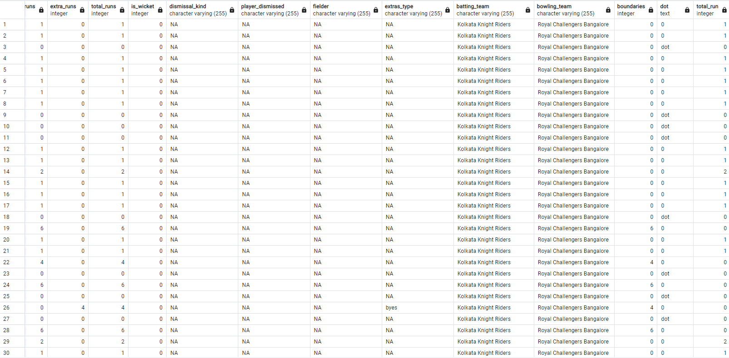

Slide 25
3. Write a query to fetch the total number of boundaries and dot balls from the deliveries_v02 table.
QUERY:-
select batting_team,
count(case when boundaries>='4' then boundaries end) as total_no_of_boundaries,
count(case when dot='dot' then dot end) as dot_balls
from deliveries_v02
group by batting_team;

Slide 27
4. Write a query to fetch the total number of boundaries scored by each team from the deliveries_v02 table and order it in descending order of the number of boundaries scored.
QUERY:-
select batting_team,
count(case when boundaries>='4' then boundaries end) as total_no_of_boundaries
from deliveries_v02
group by batting_team
order by total_no_of_boundaries desc;

Slide 29
5. Write a query to fetch the total number of dot balls bowled by each team and order it in descending order of the total number of dot balls bowled.
QUERY:-
select bowling_team,
count(case when dot='dot' then dot end) as total_no_of_dot_balls
from deliveries_v02
group by bowling_team
order by total_no_of_dot_balls desc;

Slide 31
6. Write a query to fetch the total number of dismissals by dismissal kinds where dismissal kind is not NA.
QUERY:-
select
count(case when dismissal_kind != 'NA' then dismissal_kind end) as total_no_of_dismissal
from deliveries_v02;

Slide 32


Slide 33
7. Write a query to get the top 5 bowlers who conceded maximum extra runs from the deliveries table.
QUERY:-
select bowler,
sum(extra_runs) as max_extra_runs
from deliveries
group by bowler
order by max_extra_runs desc limit 5;

Slide 34
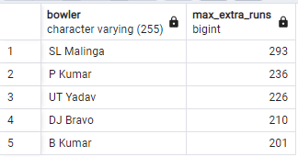

Slide 35
8. Write a query to create a table named deliveries_v03 with all the columns of deliveries_v02 table and two additional column (named venue and match_date) of venue and date from table matches.
QUERY:-
create table deliveries_v03 as
(
select a.*,
b.venue,
b.date AS match_date
from deliveries_v02 as a
left join (select id,venue,date
from matches) as b
on a.id=b.id
)
select * from deliveries_v03;

Slide 36
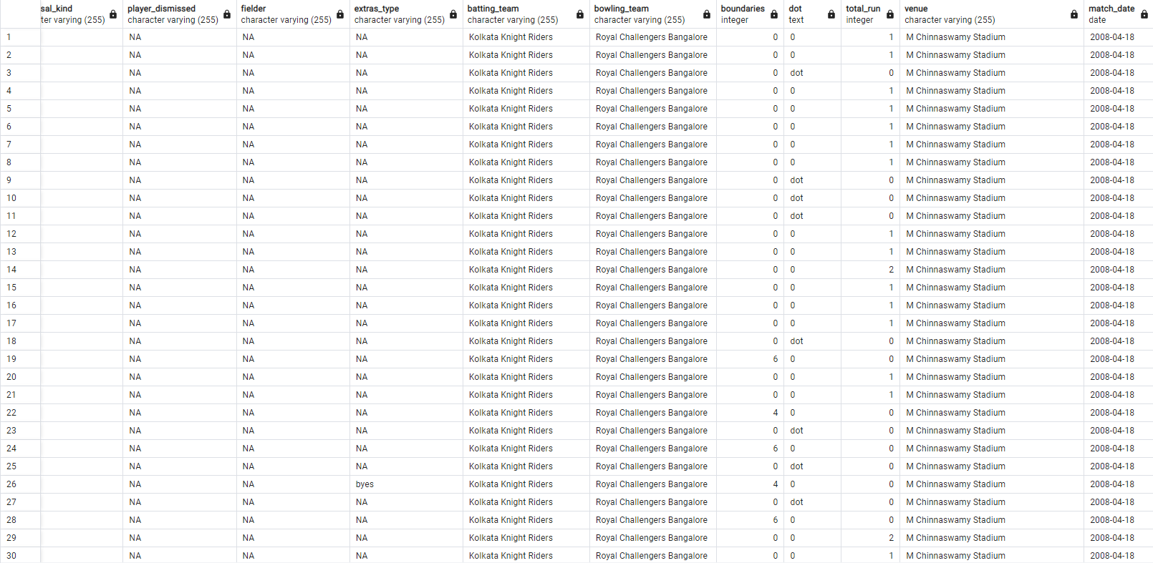

Slide 37
9. Write a query to fetch the total runs scored for each venue and order it in the descending order of total runs scored.
QUERY:-
select venue,
sum(total_runs) as total_runs_venue
from deliveries_v03
group by venue
order by total_runs_venue desc;

Slide 39
10. Write a query to fetch the year-wise total runs scored at Eden Gardens and order it in the descending order of total runs scored
QUERY:-
select venue,
extract('year' from match_date) as match_dates,
sum(total_runs) as total_runs_scored
from deliveries_v03
where venue='Eden Gardens'
group by extract('year' from match_date),venue
order by total_runs_scored desc;

Slide 40
